Slide 1
LangGraph For Multi-Agents

Slide 2
LangGraph
Framework build over LangChain that allows developers to create complex, stateful, multi-agent applications using LLMs.
User Graph based architecture : Directed Acyclic Graphs (DAG)
Small chains stitched together to form a complex graph
Enables Multi-Agents applications
Allows agents to maintain & update their memory (state) on the fly
Enables observability when integrated with LangSmith or LangFuse like tools
Scalability
Doc link

Slide 3
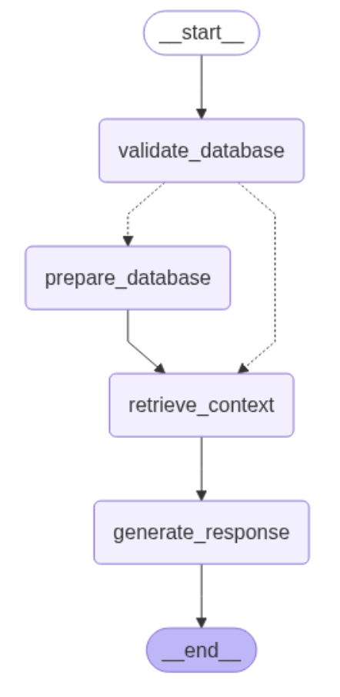
Common Terminologies:
State
Nodes
Edges
Conditional Edges
START , END

Slide 4
Building Agent with LangGraph
Simple Conversation
RAG ChatBot

Slide 5
Other important frameworks
LangFuse
LangSmith
LangFlow

Slide 6
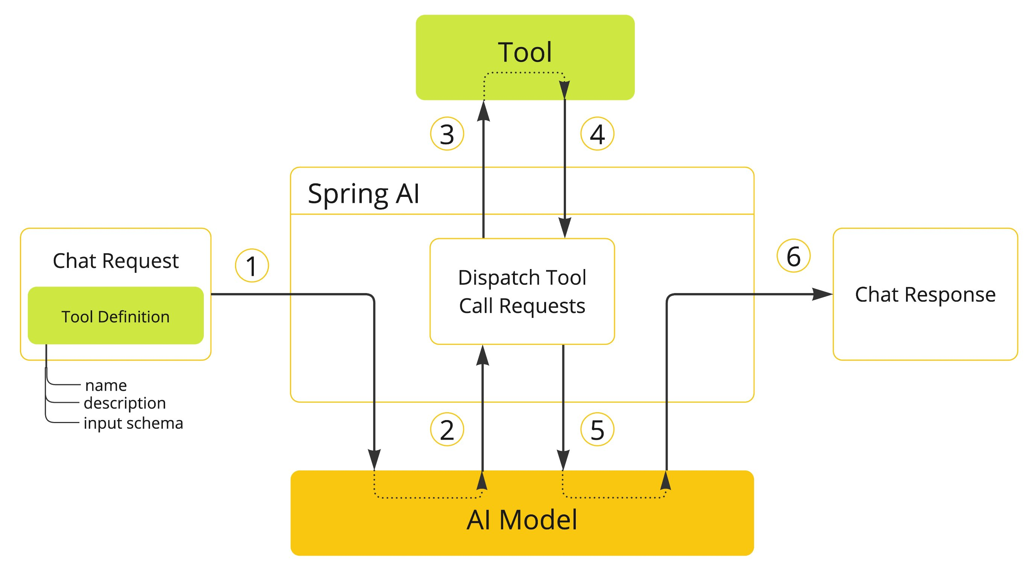
Tools
Enables LLM / Agents to take action
Decision vs Action
Can be custom script , API calls, etc.
Tool Calling:
Tools integrated with LLM
Allows LLM to work independentlyand finish a task
LLM to interaction to external world

Slide 7
How to Build a tool ?
Weather tool
Web scraping tool
Web search tool
Vector database retriever tool

Slide 8
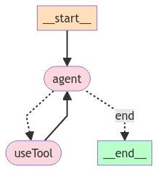
ReAct Agent
Agent with Reasoning + Action
Combine Chain-of-Thought reasoning with external tool use
Single Agent with multiple tools
Agents independently calls the tools based on its reasoning
The reasoning is refined while planning for subsequent actions
Goal oriented agent
LangGraph Multi-Agent (link)

Slide 9
Agents at work:
multiple Assistant agents working with Supervisor agent
Coder framework with multiple agents like coder, executor, tester, debugger agent working together
Travel Agent in multiple agent framework. Supervisor working with flight booking Agent, hotel booking agent, etc.
Planner-Executor Agent

Slide 10

Questions ?

